Slide 1

Security

Slide 2
大綱
Restful API- 以 FHIR API 為例
Restful API 的安全議題
FHIR 安全規範

Slide 3
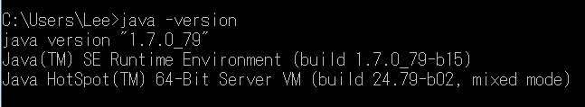
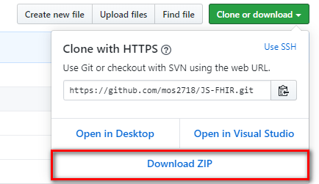
環境準備
Java 7以上，下載安裝 JAVA JRE/JDK
https://www.oracle.com/technetwork/java/javase/downloads/index.html
下載 HAPI FHIR CLI Server 3.8.0
https://github.com/jamesagnew/hapi-fhir/releases
https://github.com/jamesagnew/hapi-fhir/releases/download/v3.8.0/hapi-fhir-3.8.0-cli.zip
POSTMAN
https://www.getpostman.com/apps
FHIR JS Example
https://github.com/mos2718/JS-FHIR
FHIR
Server
FHIR
Client

Slide 4
醫療健康 API 生態系
在一定的安全機制下，跨系統互通醫療健康資料
跨平台 Cross Platform
微服務架構 Micro Service Architecture
資源導向設計 Resource-Oriented Computing
微型化的資料存取 Granularity Data Access

Slide 5
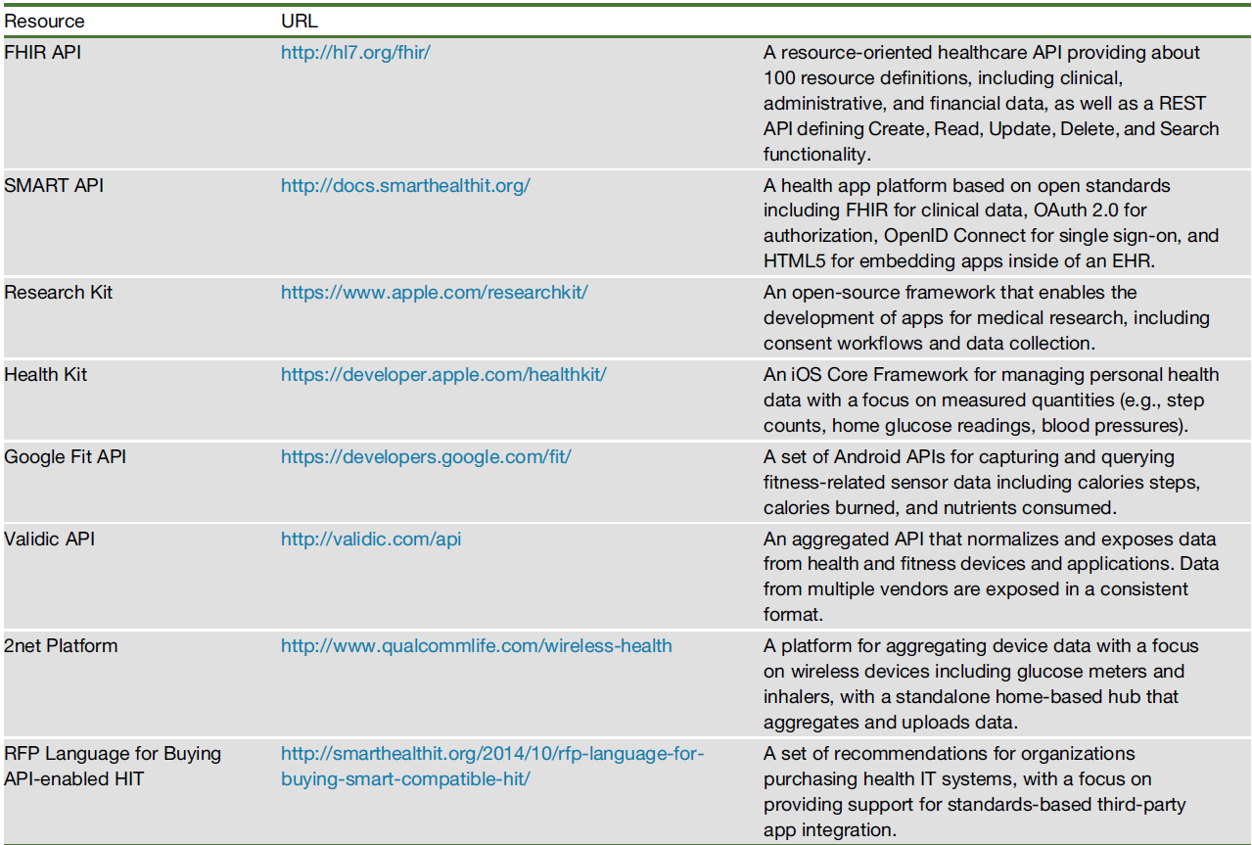

Slide 6
USA Meaningful Use Stage 3 US law on interoperability
ONC didn’t specify that the API has to be FHIR, something on the order of 110 to 120 EHR vendors have certified their systems with a consumer-facing API—and, something like
50 % of those are FHIR-based APIs.
Micky Tripathi, manager of the Argonaut Project
May 14, 2018
https://www.healthdatamanagement.com/news/fhir-information-exchange-capability-now-coming-of-age
Objectives and Measures for Stage 3 of the EHR Incentive Programs:
Objective 5: Patient Electronic Access to Health Information
Objective 6: Coordination of Care Through Patient Engagement
This proposed Stage 3 objective for Patient Electronic Access:
View their health information
Download their health information
Transmit their health information to a third party
Access their health information through an API
Electronic Health Record Incentive Program-Stage 3 and Modifications to Meaningful Use in 2015 Through 2017
2015 Edition Base Electronic Health Record (EHR) Definition, and ONC Health IT Certification Program Modifications

Slide 7
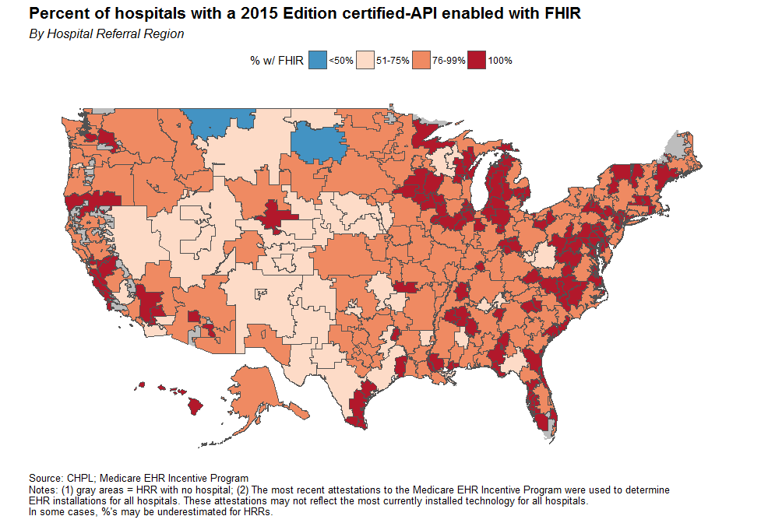
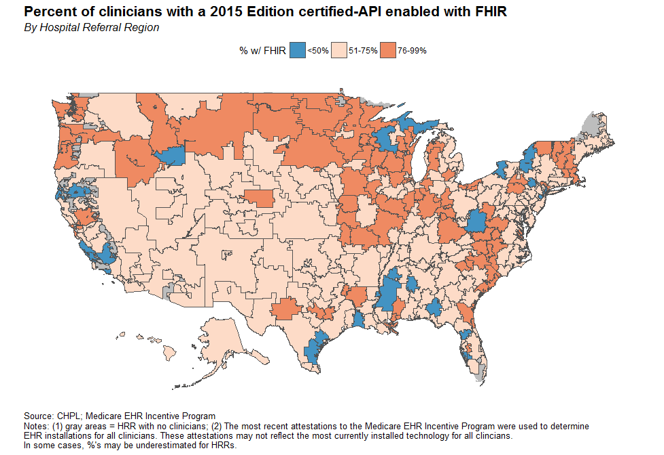
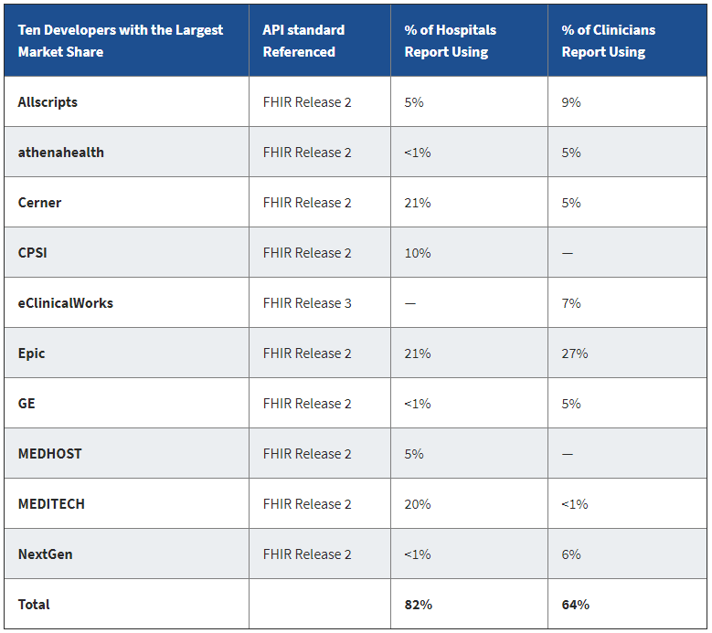
Heat Wave: The U.S. is Poised to Catch FHIR in 2019
Steven Posnack, M.S., M.H.S. and Wes Barker OCTOBER 1, 2018
Today –
Apple (with a FHIR-based “client” app) may be the most notable, but there are indications that many other big tech companies are also planning to use the standard.
The Centers for Medicare & Medicaid Services (CMS) has reaffirmed in its rules affecting the Promoting Interoperability that the 2015 Edition will be required in 2019.

Slide 8
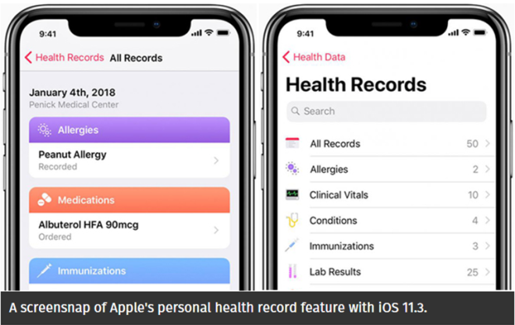
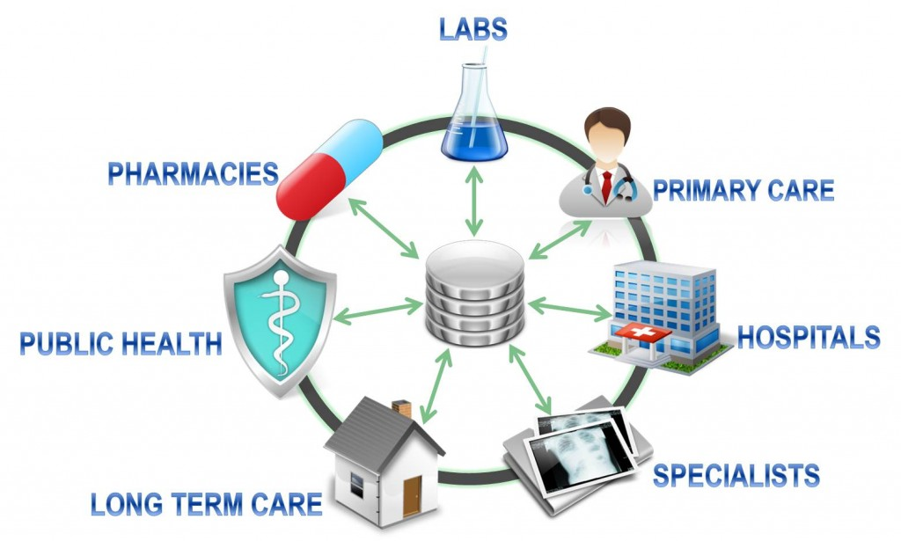
美國FHIR發展概況
FHIR
美國iPhone用戶已能歸人互通
全美380家醫療集團之EHR
可由個人授權給指定的第三方 服務單位存取運用完整的PHR
以提供有效的連續性整合照護
全美逾80%健康照護機構/廠商
支援以FHIR跨機構互通EHR
區域自訂健康資料互通範圍
與隱私/資安授權政策
ONC Argonaut Project FHIR基礎建設
區域/聯盟互通規範
下一代
健康照護應用 & AI

Slide 9
系統整合等級
Interoperability
互操作性
雙方採用標準介面
系統互操作性
One Ecosystem
以秒 為單位
A系統
B系統
標準化
雙方採用標準介面
系統互通互連
One Standard
以日 為單位
A系統
B系統
談介接
雙方協調介接介面
系統整合
Case by Case
以月 為單位
A系統
B系統

Slide 10
Institutions that support health records on iPhone and iPod touch
382 institutions Published Date: October 23, 2019
63 institutions
307 institutions
196 days
441 days
3.11 days/per institution
1.44 days/per institution
12 hospitals
75 health systems
382 institutions
2018/1/24
2018/8/8
2019/10/23

Slide 11

FHIR 標準簡介
http://hl7.org/fhir/

Slide 12
FHIR Wiki http://wiki.hl7.org/index.php?title=FHIR
FHIR Chat (Zulip)
FHIR Starter
FHIR Teaching
FHIR for Clinical Users
FHIR blogs David Hay
Publicly Available FHIR Servers for testing
Open Source FHIR implementations
ClinFHIR - web-based generic FHIR client
Historical Connectathons (list)

Slide 13








FHIR Resource 抽象化設計範例
Abstraction
歸納共通性
Car
Organization
Practitioner
Identifier:
Identifier:
OID, 醫事機構碼
部門/科別代碼
Identifier:
員工帳號,
醫事人員代碼
身分證號
Type:
Taxi, Police Car,
Ambulance
Type:
Hospital, Clinic, Pharmacy,
Nursing Home
Type:
Doctor, Nurse,
Pharmacist,
Medical administration

Slide 14
Patient Resource
Http Operation
Service Base
Resource
Id
Method
GET http://spark.furore.com/fhir/Patient
取得病患清單
POST http://spark.furore.com/fhir/Patient
建立新病患
GET http://spark.furore.com/fhir/Patient/1
取得病患1
PUT http://spark.furore.com/fhir/Patient/1
更新病患1
DELETE http://spark.furore.com/fhir/Patient/1
刪除病患1
Create
Read
Update
Delete

Slide 15
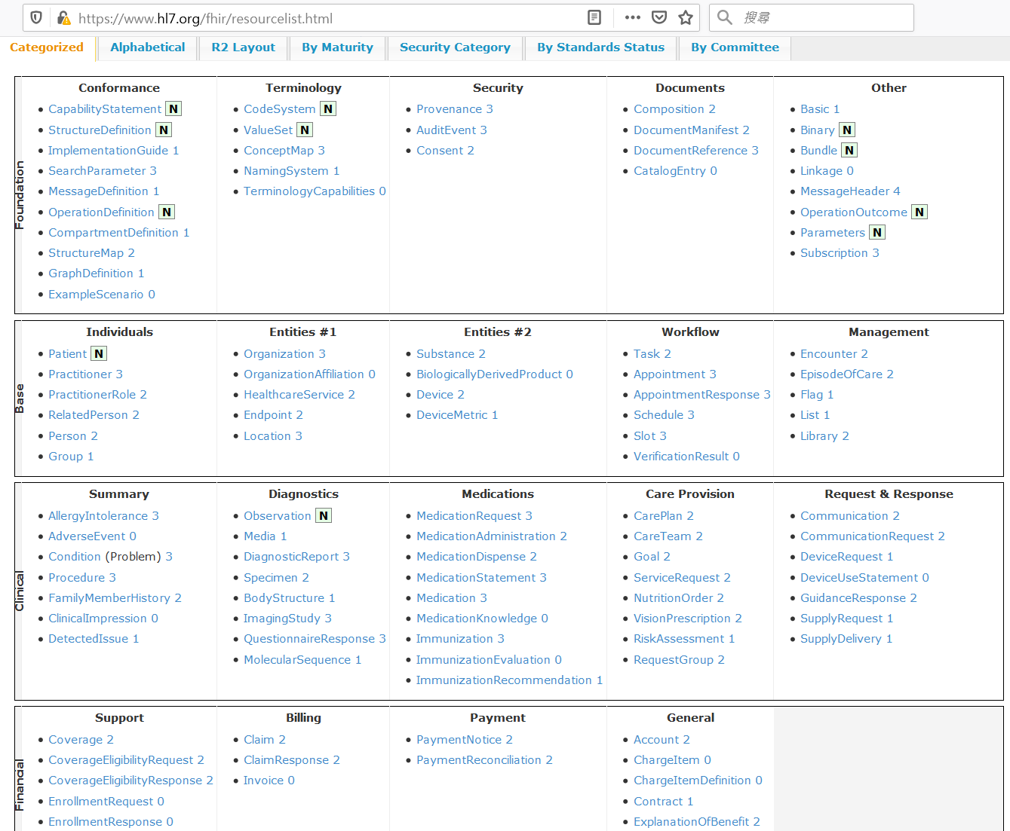

Slide 16
Core/Utility Resources
Core Resources: 鐵三角
Patient
Organization
Practitioner
Utility Resources: 基本資料型別 (primitive type)
List
Composition
Binary
Media
Bundle
Encounter
醫療照護事件的人事時地物

Slide 17
Clinical Resources
Summary Resource:
Condition (Problem)
Procedure
FamilyMemberHistory
Diagnostic Resources:
Observation
DiagnosticReport
Specimen
BodySite
ImagingStudy
QuestionnaireResponse
MolecularSequence
所有症狀/主訴/臆斷/診斷
所有處置
病史/家族病史
所有客觀檢驗檢查觀察值
加上人為解釋/臆斷的檢驗檢查報告
等義於 DICOM Study
臨床問卷/量表填答結果
基因序列

Slide 18
Clinical Resources
Medications Resources:
MedicationRequest
MedicationDispense
MedicationAdministration
Prescribe 開處方 -> Dispense 發藥 -> Administer 領/用藥
MedicationStatement
Medication
Immunization
ImmunizationRecommendation
Active Medications List/Summarization

Slide 19
EMR (CDA) -> EHR (FHIR)
Clinical Scenario
電子病歷資料來源：
1.醫學影像報告
2.出院病摘
3.檢驗報告
4.門診病歷(含門診用藥)
Patient
List
List
List
List
Condition
(Diagnosis)
Medication
Request
Procedure
Observation
(Examination Result)
Diagnostic
Report
(Imaging Report)
Encounter
Medication
Encounter
Specimen
Imaging
Study

Slide 20
Care Resources
Care Provision Resources:
CarePlan
CareTeam
Goal
ReferralRequest
ProcedureRequest
NutritionOrder
RiskAssessment
照護計畫
照護團隊
照護目標
轉診請求
處置請求
營養醫囑
風險評估

Slide 21
Base Resource
Individuals Resources:
Person
RelatedPerson
PractitionerRole
Group
Entities Resources:
Location
Device
DeviceComponent
DeviceMetric
HealthcareService
自然人可用來歸戶
關係人(家屬、照護者等)
醫護人員角色與多點執業
Patient/Practitioner/Device/Medication/Substance
設備元件
設備序列
醫療照護服務類別

Slide 22
Terminology / Documents Resources
Terminology Resources:
CodeSystem
ValueSet
ConceptMap
Documents Resources:
DocumentReference
DocumentManifest
編碼系統 Ex: ICD10, LOINC, ATC, 健保代碼等
列舉值域
兩個以上CodeSystem 對照 Ex: 院內碼 to 健保碼, ICD9 to ICD10
(臨床)文件參考
文件索引

Slide 23
Scheduling / Security Resources
Scheduling Resources:
Appointment
AppointmentResponse
Schedule
Slot
Security & Privacy Resources:
AuditEvent
Consent
Provenance
Bundle
預約 Booking
預約確認 Booking Confirm
班表
班表中的一格時段
稽核記錄 繼承自IHE-ATNA
同意書
人對事件的(簽章)授權
除了是 Search Return Results 以外
還是 FHIR Resources 的簽章結構

Slide 24
Clinical Reasoning Resource
DecisionSupportServiceModule
GuidanceResponse
Measure
MeasureReport
ActivityDefinition
ServiceDefinition
PlanDefinition

Slide 25
Financial & Insurance Resources
Coverage 保險方案 / 身分
EligibilityRequest 保險身分確認請求
EligibilityResponse 保險身分確認回覆(給付額度/報銷條件)
EnrollmentRequest 保健方案請求
EnrollmentResponse 保健方案回覆
Claim 申報/應收帳款 (後台帳)
ClaimResponse 核付/支付
PaymentNotice 收據
PaymentReconciliation 對帳單
ExplanationOfBenefit 支付紀錄
Account 帳戶
ChargeItem 計費項目 (前台帳)

Slide 26
It’s all about combining resources . . .
http://lab.hospitalA.org/Observation/3ff27
http://moh.govt.nz/nhi/Patient/223
Observation
Patient
Diagnostic
Report
Organization
http://lab.hospitalA.org/DiagnosticReport/4445
Practitioner
http://moh.govt.nz/hpi/Organization/1
http://moh.govt.nz/hpi/Practitioner/87

Slide 27
Web service 資安疑慮

Slide 28
Web service 資安疑慮
手機 APP 呼叫 web services 的資安疑慮
呼叫前有認證嗎?
傳輸之訊息有否加密?
用甚麼加密機制?
他人開發之 APP 可否連到你的 web services
認證及授權機制為何?

Slide 29
FHIR 安全性

Slide 30
常見之資訊互通資安要求
Communications security
User Authentication
Authorization
Relationship to Privacy Consent
Audit Logging and reporting

Slide 31
基於 PKI solution 之資安保護
什麼是 PKI
公私鑰可做什麼?
CA 是什麼，為何要有 CA ?

Slide 32
Security Certification Criteria
To be certified for the "API" criteria, a Health IT Module must certify to following security criteria:
Authentication, access control, and authorization
Trusted connection
Auditing actions on health information
SMART on FHIR
TLS (https) or VPN
FHIR AuditEvent Resource
2015 Edition Health IT Certification Criterion
Section 170.315(d)
The Office of the National Coordinator (ONC), US published

Slide 33
SMART & SHARP Project (2010 – 2014)
U.S. Government
Office of the National Coordinator of Health Information Technology (ONC)
Fund
Strategic Health IT Advanced Research Projects (SHARP)
Sub Project
Substitutable Medical Applications & Reusable Technology (SMART)

Slide 34
SMART on FHIR
SMART on FHIR is a set of open specifications to integrate apps with EHRs:
Clean, structured data: FHIR
Scopes and permissions: OAuth2
Simple sign-in: OpenID Connect
Lightweight UI integration: HTML5
http://docs.smarthealthit.org/

Slide 35
SMART on FHIR Concept
Authentication
Health App
OpenID Connect
EHR
Health App
FHIR
EHR
Health App
OAuth2
EHR
Authorization
Write once, run anywhere

Slide 36
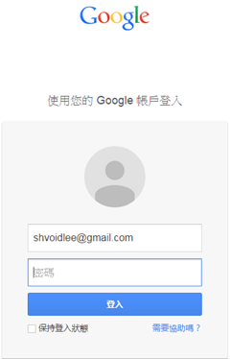
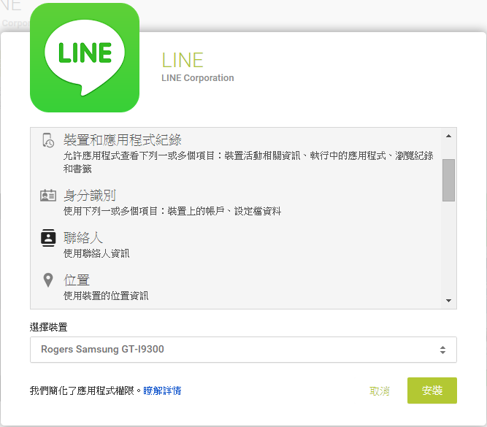
其實大家每天都在使用 只是不知道背後支持的標準
OpenID Authentication
OAuth2
Authorization

Slide 37
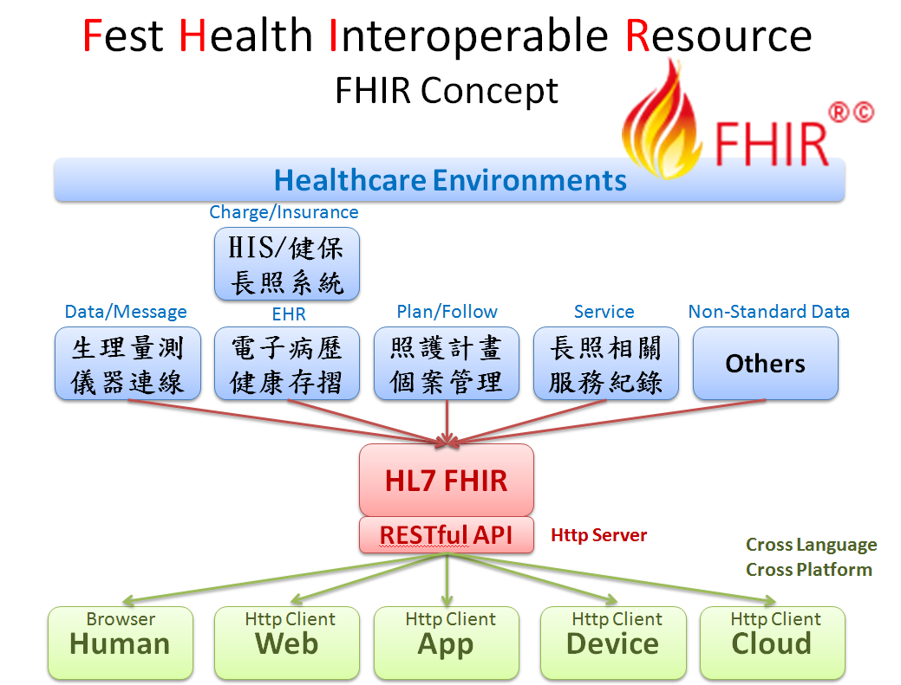

Slide 38
SMART on FHIR One Ecosystem
標準化區域健康照護資訊互通平台
各廠應用系統
身份驗證
Authentication
各家醫護單位
健康福祉 整合服務平台
Health App
OpenID Connect
花蓮慈院關山慈院
遠傳
遠距儀器平台
Health App
FHIR
花蓮秀林 台東海端
衛生所
大同
HIS
OAuth2
區域其他 照護單位
諾亞克
長照服務平台
Authorization
授權範圍

Slide 39
SMART & SHARP Project
U.S. Government
Office of the National Coordinator of Health Information Technology (ONC)
Fund
Strategic Health IT Advanced Research Projects (SHARP)
Sub Project
Substitutable Medical Applications & Reusable Technology (SMART)

Slide 40
SMART on FHIR (FHIR Security Framework)
由美國政府直接投資研發，成果公佈於2014年 以4個國際開放資訊標準結合運用而成，現已納入FHIR標準持續維護擴充
SMART on FHIR
FHIR
HTML5
OAuth2
OpenID Connect
Compliance with USA HIPPA
will Compliance with EU GDPR
作為 FHIR 主要隱私授權與資安保護機制
可由個人直接授權指定範圍的資料才能被指定第三方應用存取
符合台灣個資法告知蒐集處理利用及經當事人同意等規範

Slide 41
其實大家日常每天都在用
Authentication
Authorization
OpenID Connect
OAuth2

Slide 42

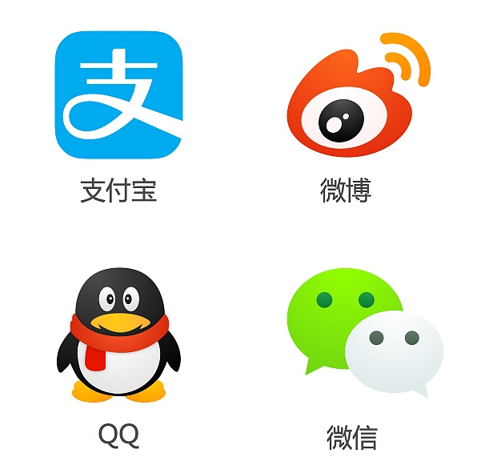

OpenID + OAuth2 商用案例

Slide 43
Security Certification Criteria
To be certified for the "API" criteria, a Health IT Module must certify to following security criteria:
Authentication, access control, and authorization
Trusted connection
Auditing actions on health information
SMART on FHIR
TLS (https) or VPN
FHIR AuditEvent Resource
2015 Edition Health IT Certification Criterion
Section 170.315(d)
The Office of the National Coordinator (ONC), US published

Slide 44
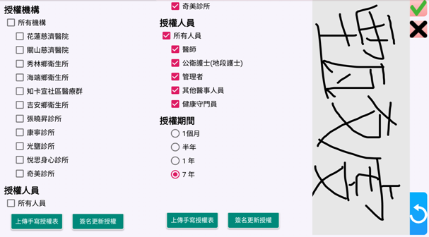



花蓮慈濟健康福祉計畫資料互通隱私授權情境
授權機構角色範圍 手寫簽名
健康照護者
既有應用系統:
計畫個管平臺
HIS、遠距
早療、長照
C1.登入既有
平臺系統
帳號整合
依機構角色
取得授權範圍
(API)
P1.下載App註冊
民眾
OpenID 互通平台帳號
OAuth 資料授權管理
FHIR
P2.自訂授權範圍
- 授權機構
- 授權角色
C2. 查閱該機構&角色
已被民眾授權的資料
花東地區
衛生所

Slide 45
互通平台第三方應用系統整合方案
1. 註冊維護流程
向 OAuth
註冊Client ID
向 OAuth
取得 Access Token
向 FHIR
維護帳號權限
Practitioner
PractitionerRole
操作管理介面
OAuth API
FHIR API
2. 資料上傳流程
第三方應用系統
帳號&腳色維護於 FHIR Server
提供 API 自行維護
以機構管理員
腳色向OAuth
取Access Token
向 FHIR
建立/更新
機構互通資料
OAuth API
FHIR API
民眾帳號由 App 介面註冊
維護於 OpenID Server
提供管理介面維護
3. 資料讀取流程
以使用者腳色向OAuth
取Access Token
向 FHIR
查詢/讀取
區域互通資料
OAuth API
FHIR API

Slide 46
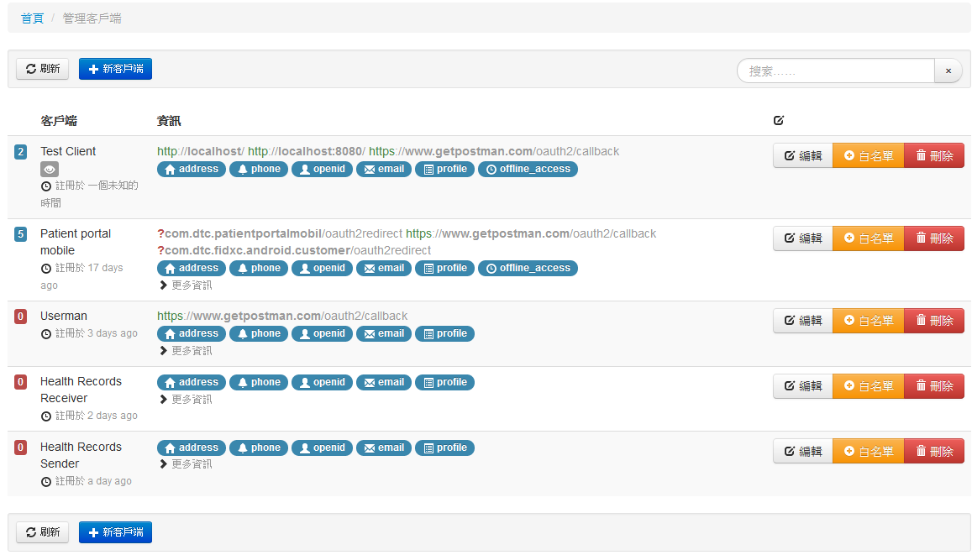
OAuth Client(Applications) 管理
健康存摺 App
OpenID 管理服務
健康存摺上傳FHIR服務
醫療院所上傳FHIR服務

Slide 47
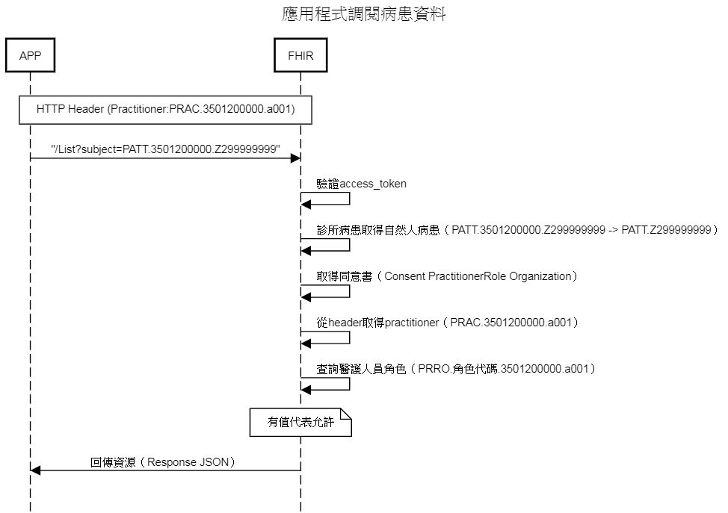

Slide 48
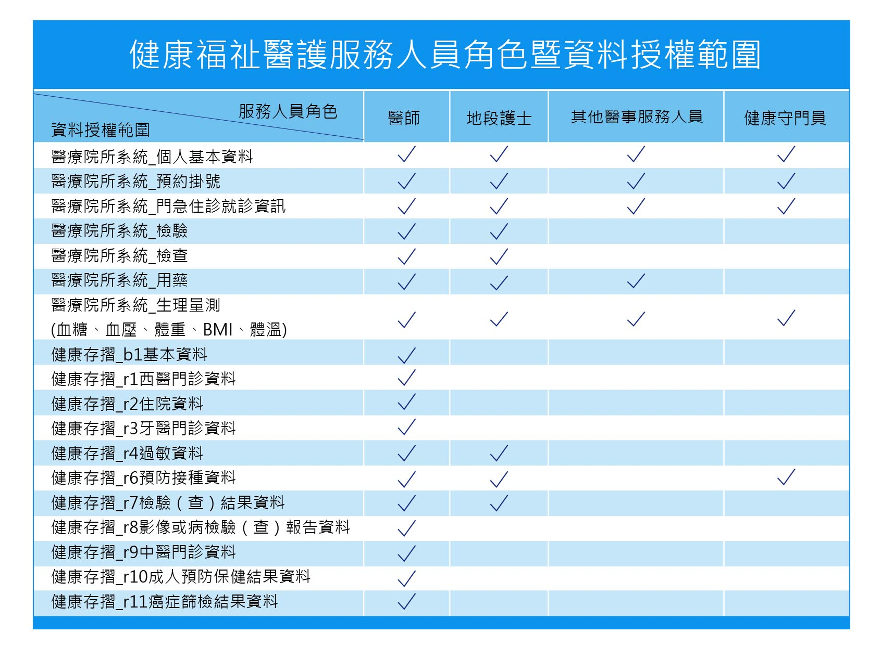

Slide 49
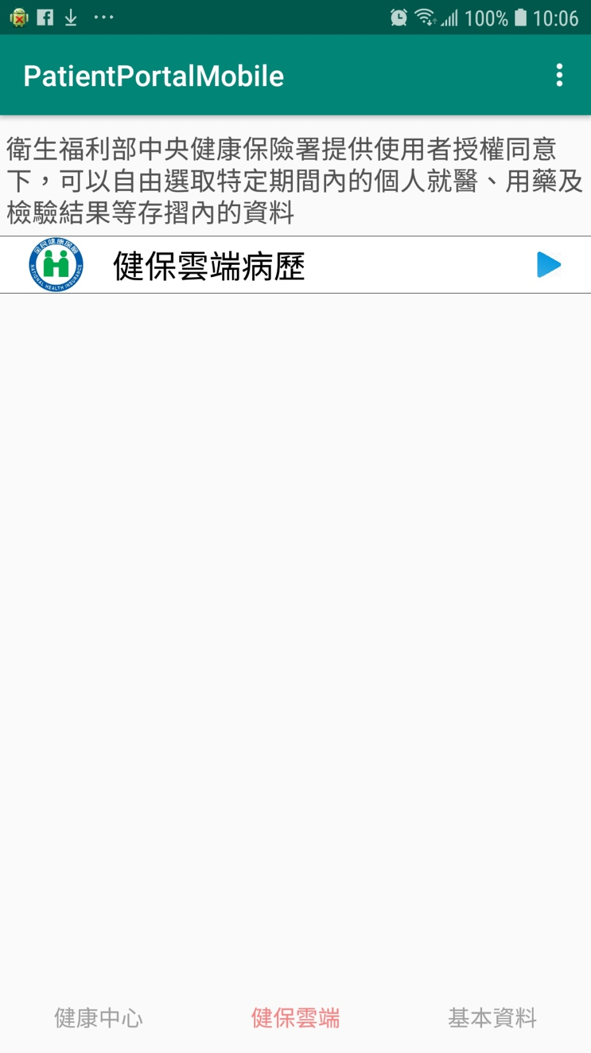
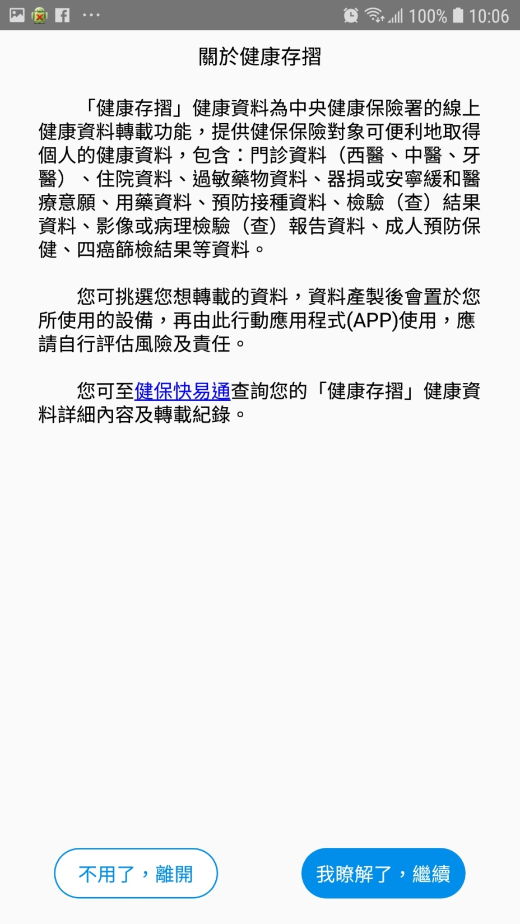

Slide 50
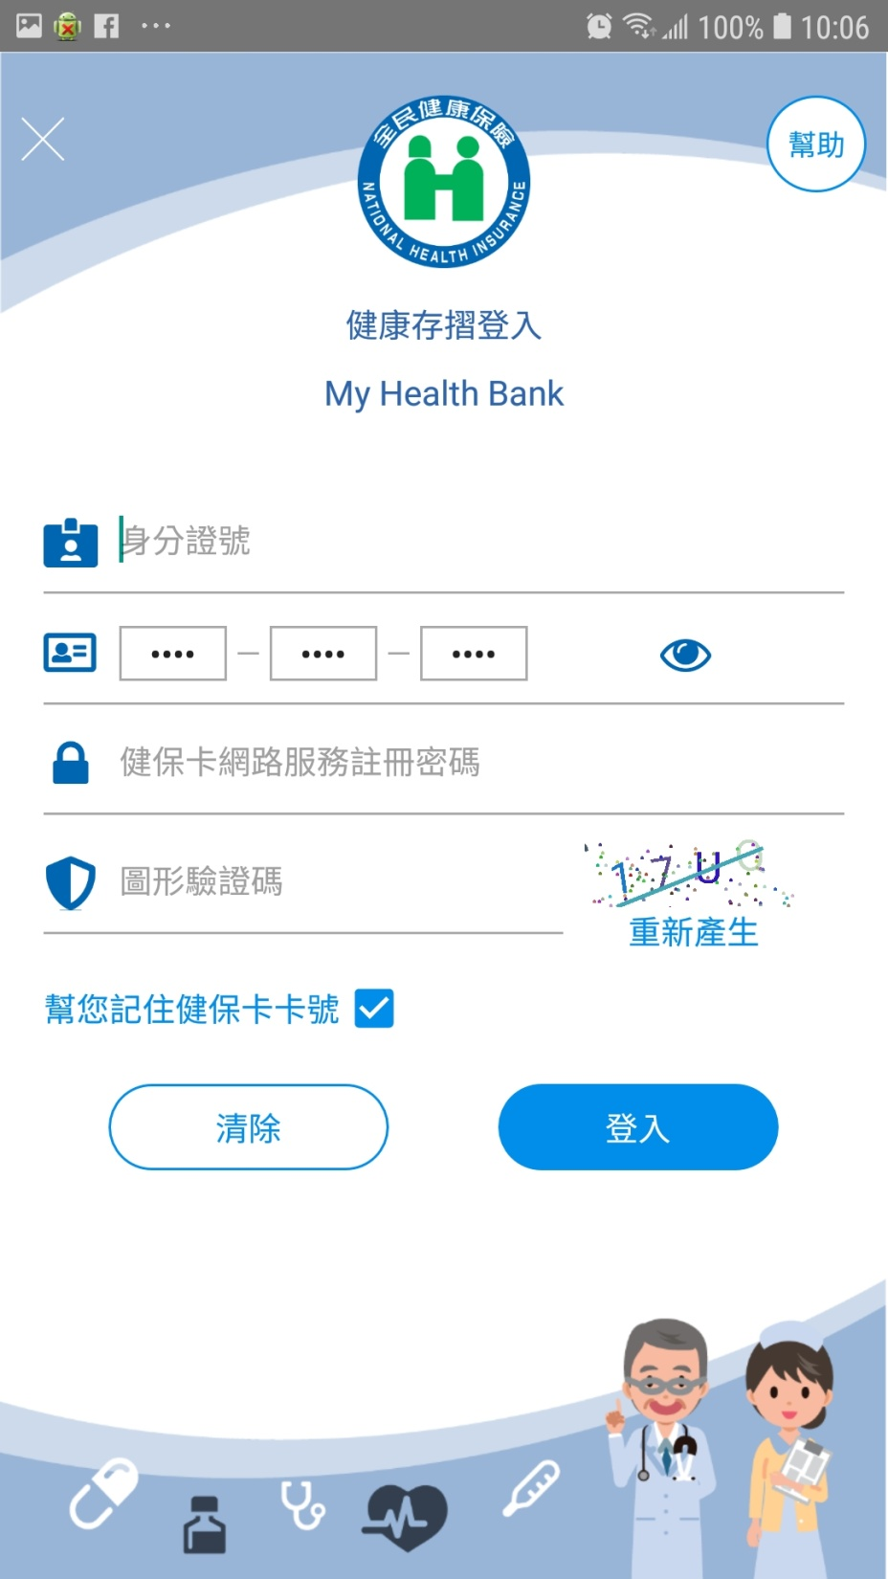
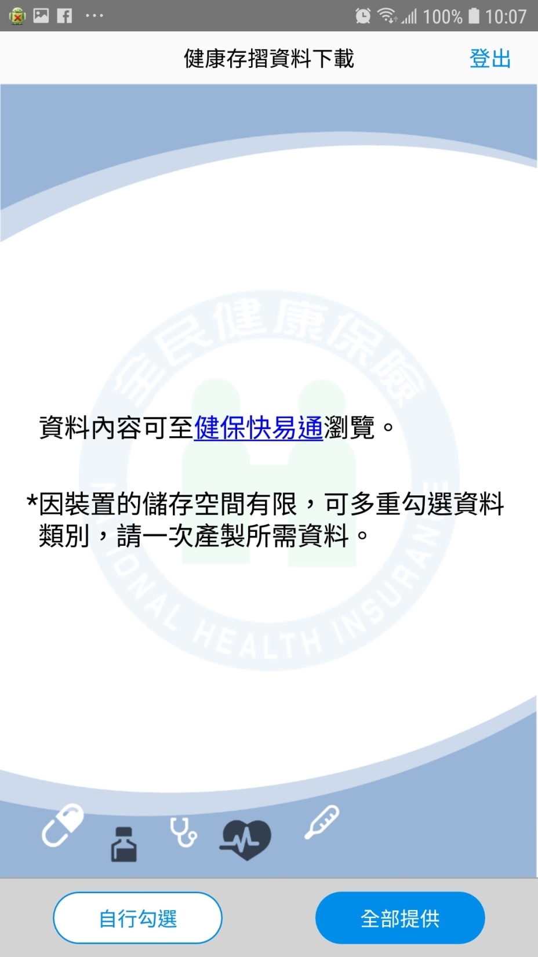

Slide 51
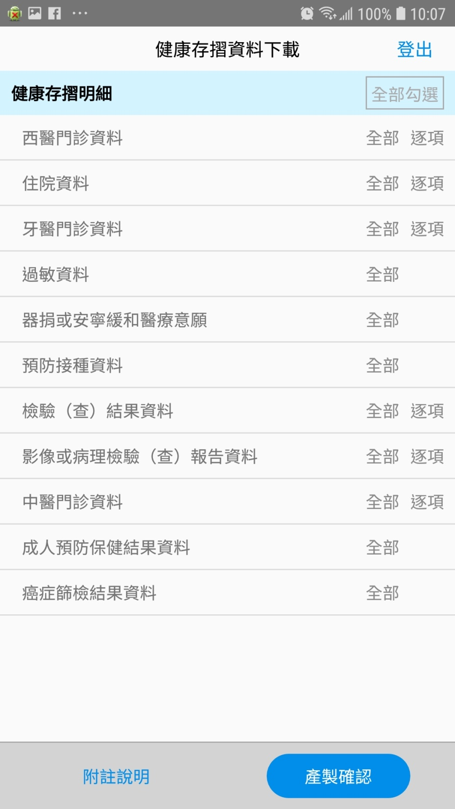
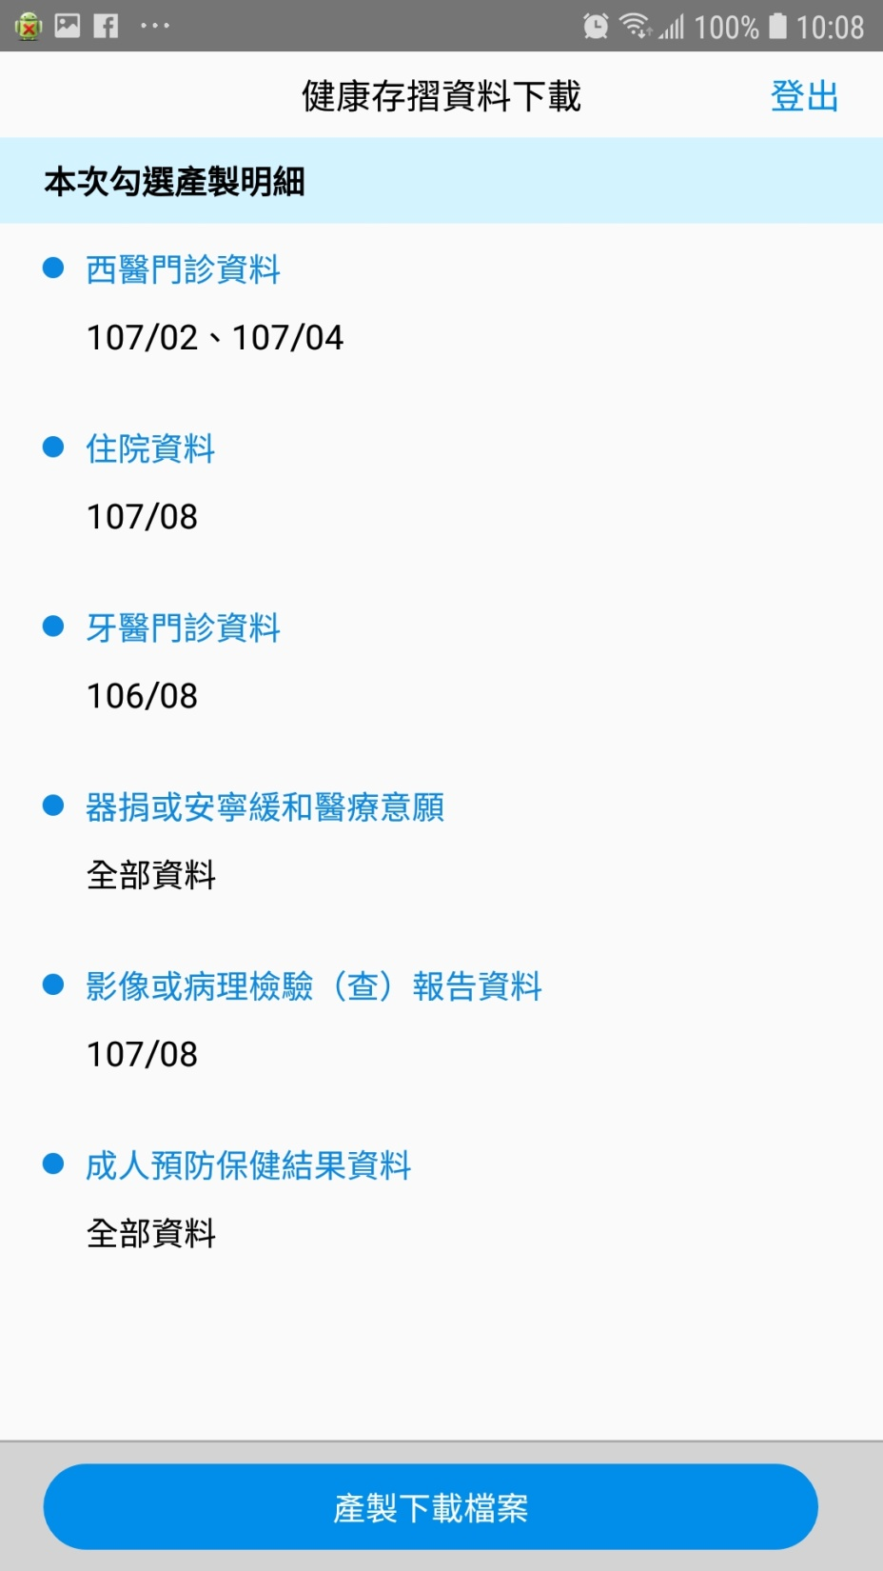

Slide 52
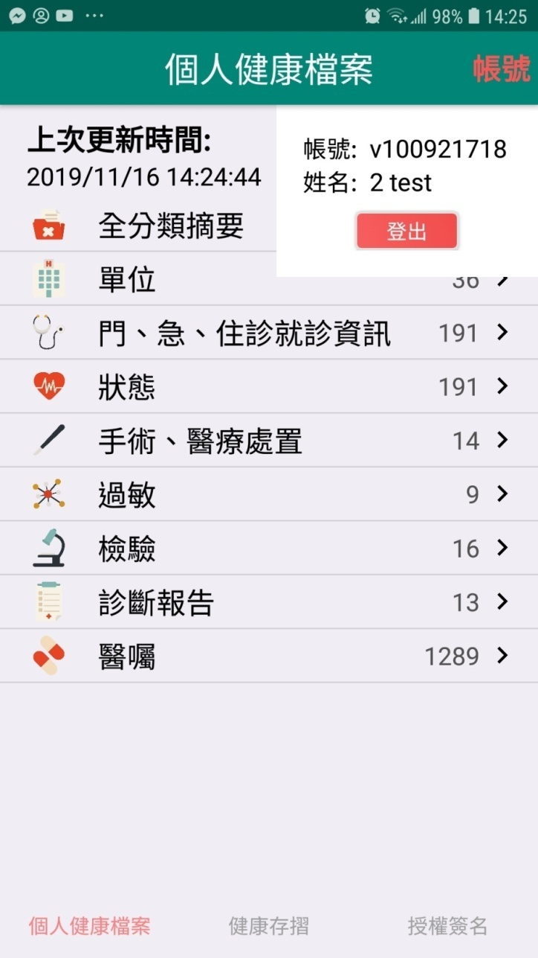
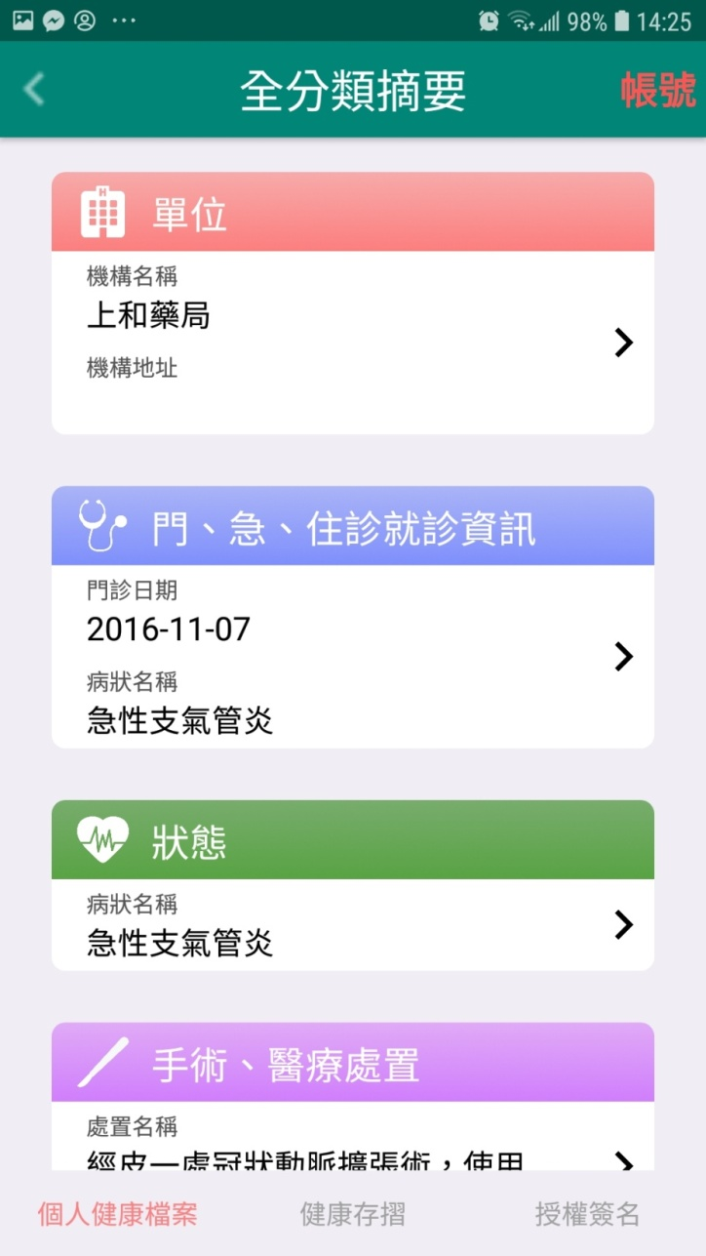
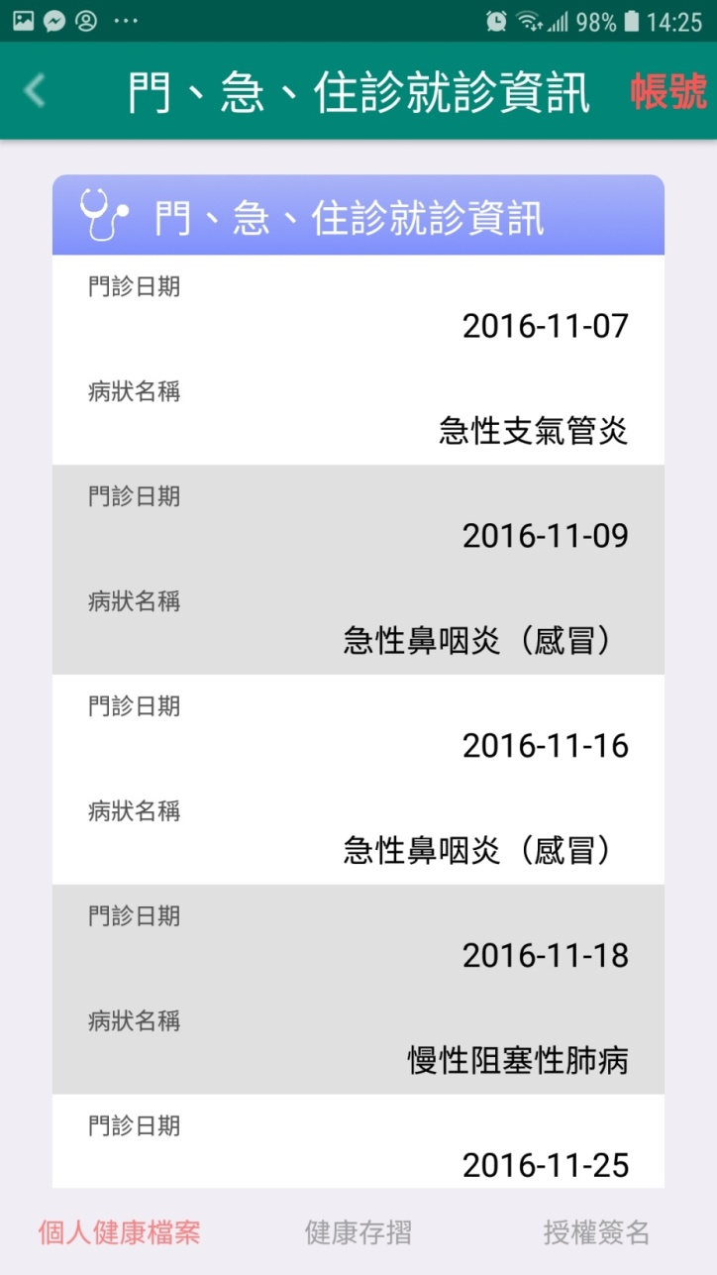
花蓮慈濟健康福祉 App 個人健康檔案(PHR) 整合：
健康存摺、衛生所、慈濟醫院、守門員生理量測
且提供 FHIR API (經民眾授權) 供互通聯盟成員第三方應用系統整合

Slide 53
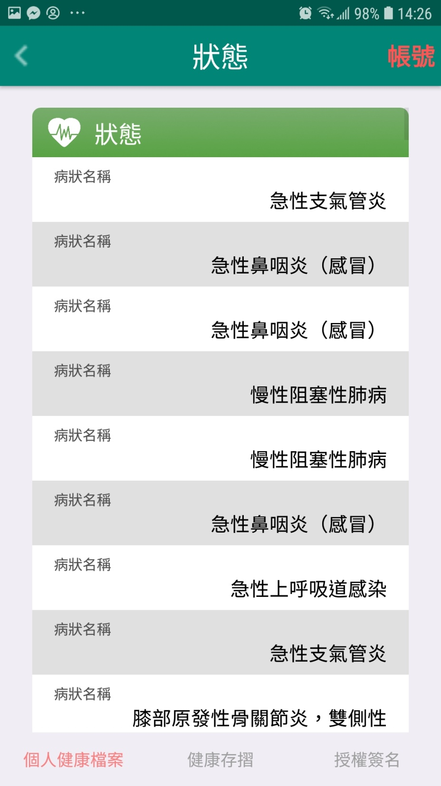
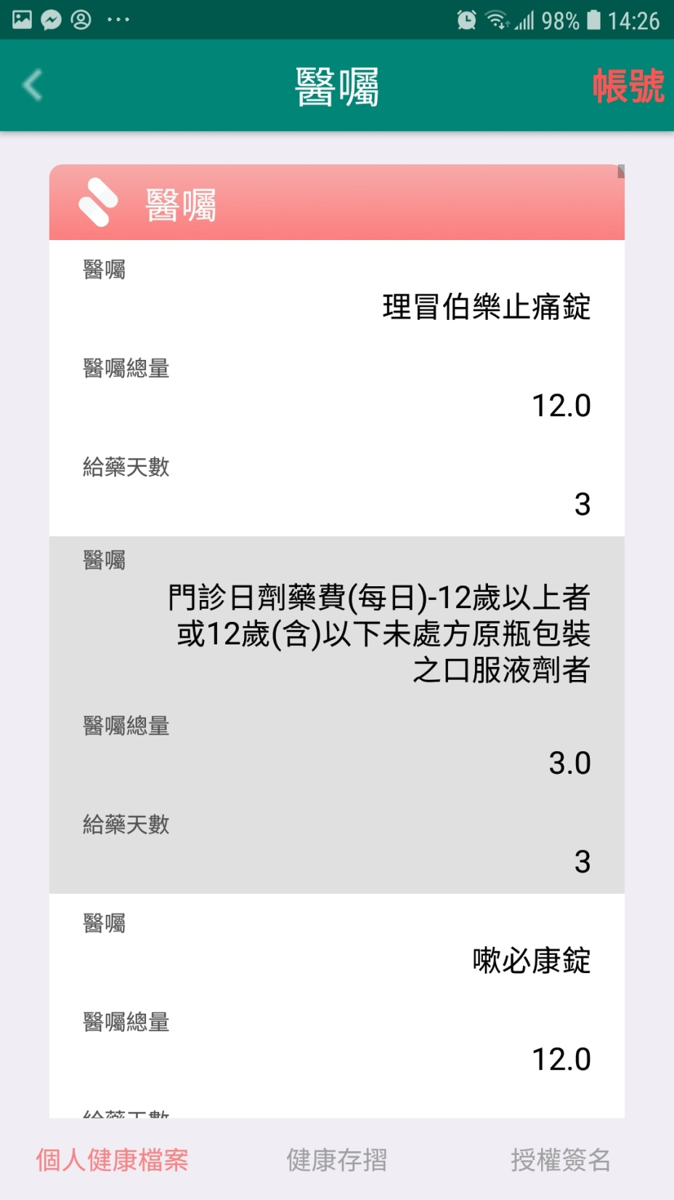

Slide 54
